Slide 1
Capstone Project
EDA capstone on Play Store App Review Analysis
By – HRITIK SAINI , ARPIT DARGAN

Slide 2

Content:
Understanding Data Analysis
Problem Statement and Challenges
Steps involved
Data cleaning
Purpose of this Project
Data visualization with Plots.
Conclusion

Slide 3

What Is Data Analysis?
Data analytics is the science of analyzing raw data to make conclusions about that information. Many of the techniques and processes of data analytics have been automated into mechanical processes
and algorithm that work over raw data for human consumption.

Slide 4





Data Analysis Steps :
The first step is to determine the data requirements or how the data is grouped. Data may be separated by age, demographic, income, or gender. Data values may be numerical or be divided by category.
The second step in data analytics is the process of collecting it. This can be done through a variety of sources such as computers, online sources, cameras, environmental sources, or through personnel.
Once the data is collected, it must be organized so it can be analyzed. This may take place on a spreadsheet or other form of software that can take statistical data.
The data is then cleaned up before analysis. This means it is scrubbed and checked to ensure there is no duplication or error, and that it is not incomplete. This step helps correct any errors before it goes on to a data analyst to be analyzed.

Slide 5
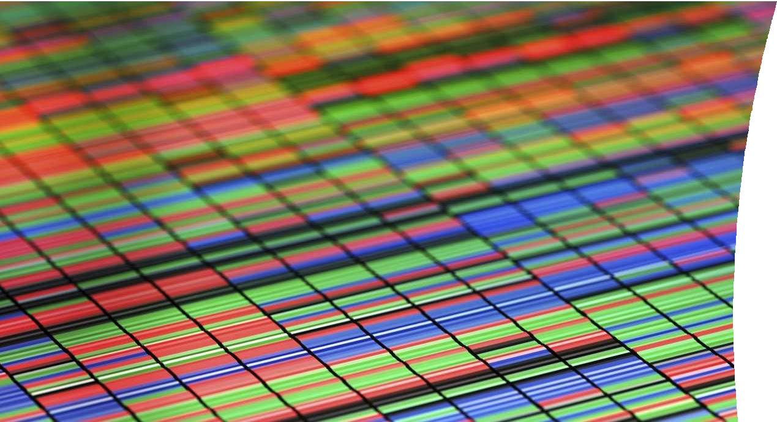


World of Applications
No, doubt Mobile Applications are trending, ever wonder why? The reasons are well known:
Makes life easy
Apps are fun
Communication and Engagement
Smart marketing, Lead generations and many more.

Slide 6

Problem Statements:
Top five category which have overall best rating.
Top five genres which have best rating.
Lets analyse the sentiments subjective and overall people sentiments.
Top five category review sentiments.
Lets check if category is free or paid.
Most reviwed apps.
Apps which have rating between 4.0 to 4.5 has nimber of installs more than 15k
Factor affecting installs.

Slide 7

CSV Files
1.Play Store Data
A pp: Name of the App.
C ategory: Category under which it falls.
R ating: Application’s rating on play store.
R eviews: No. of reviews of the app.
S ize: Size of the app.
I nstalls: No. of Installs of the app.
T ype: If the App is free/ paid.
P rice: Price of the App (o if it is free).
C ontent Rating: Appropriate target audience of the App.
G enres: Genres under which the App falls
L ast Updated: Date when the App was last updated.
C urrent Version: Current version of the App.
A ndroid Version: Minimum Android version required to run the App.

Slide 8

User Reviews
Translated Reviews : To think or talk about something again and that's it(here we are taking about reviews corresponding to the apps)
Sentiments : An attitude or opinion that is often caused or influenced by emotion here it has three categories we'll discuss this in an interesting manner.
Sentiment Polarity : For an element it defines the orientation of the expressed sentiment.
Sentiment subjective : An objective sentence expresses some factual information about the Apps.

Slide 9


What is data cleaning?
Data cleaning is the process of fixing or removing incorrect, corrupted, incorrectly formatted, duplicate, or incomplete data within a dataset. When combining multiple data sources, there are many opportunities for data to be duplicated or mislabeled. If data is incorrect, outcomes and algorithms are unreliable, even though they may look correct. There is no one absolute way to prescribe the exact steps in the data cleaning process because the processes will vary from dataset to dataset. But it is crucial to establish a template for your data cleaning process so you know you are doing it the right way every time.

Slide 10
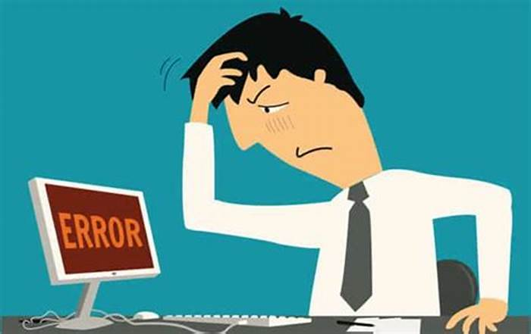
Step 2: Fix structural errors :
Structural errors are when you measure or transfer data and notice strange naming conventions, typos, or incorrect capitalization. These inconsistencies can cause mislabeled categories or classes. For example, you may find “N/A” and “Not Applicable” both appear, but they should be analyzed as the same category.

Slide 11
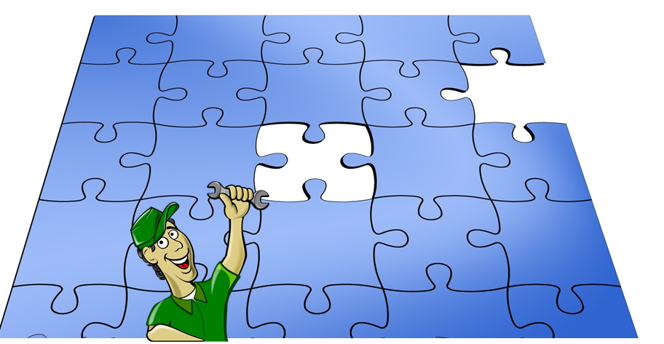
Step 3 : Handle missing data
You can’t ignore missing data because many algorithms will not accept missing values. There are a couple of ways to deal with missing data. Neither is optimal, but both can be considered.

Slide 12


The Impact of Reviews
Reviews not only have the power to influence consumer decisions but can strengthen a company’s credibility.
Reviews have the power to gain customer trust, and they encourage people to interact with the company. Customer interaction ultimately leads to improved profits for businesses.

Slide 13
Purpose of this project
This EDA project aims to discover patterns that lead to a successful application on the Play Store. This will be done by analyzing the historical data collected from the Play Store according to dataset source. We hypothesize that there are patterns within the data that lead to a successful app. We are trying find the successful pattern to develop an app that may be in the high ranks one day, help ad providers know which apps to post their
adds on.

Slide 14
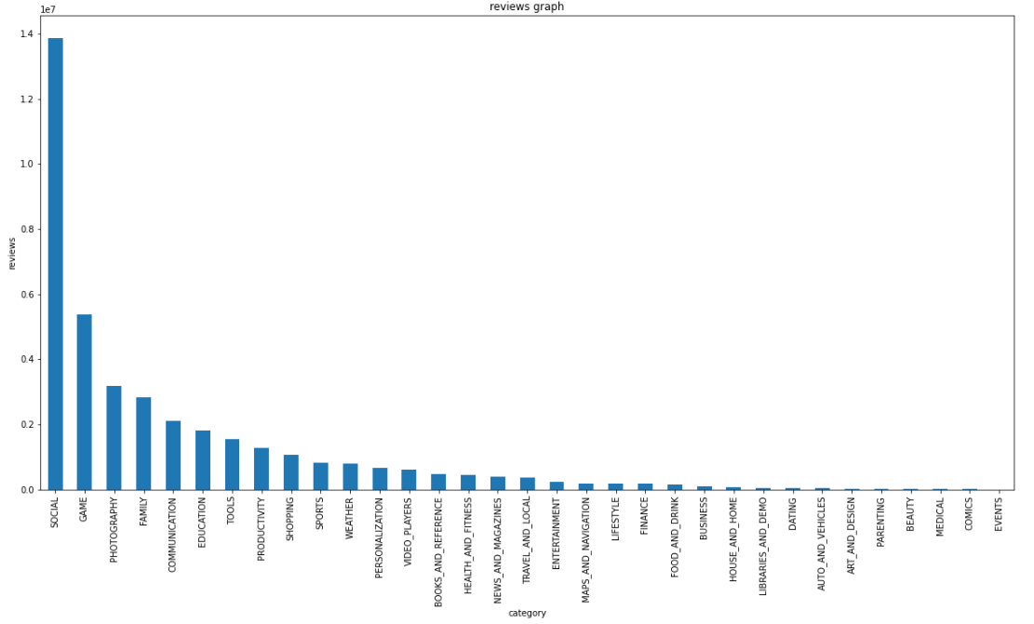
B A R P L O T A N A LY S I S
From this barplot graph analysis it tells that category social has the highest and events has the lowest

Slide 15
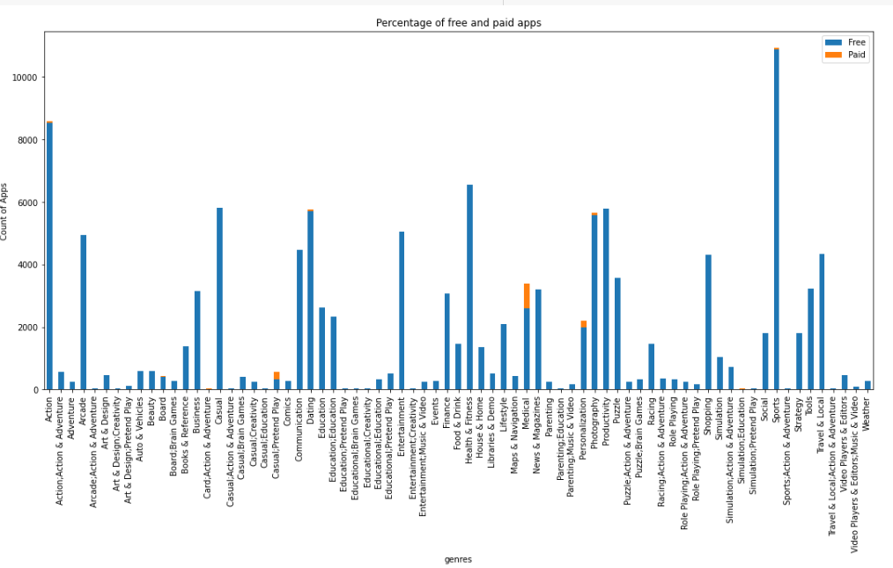
C O U N T P L O T A N A LY S I S
From the analysis it tells that only five genres have paid apps and the user more like to download free apps instead of paid apps

Slide 16
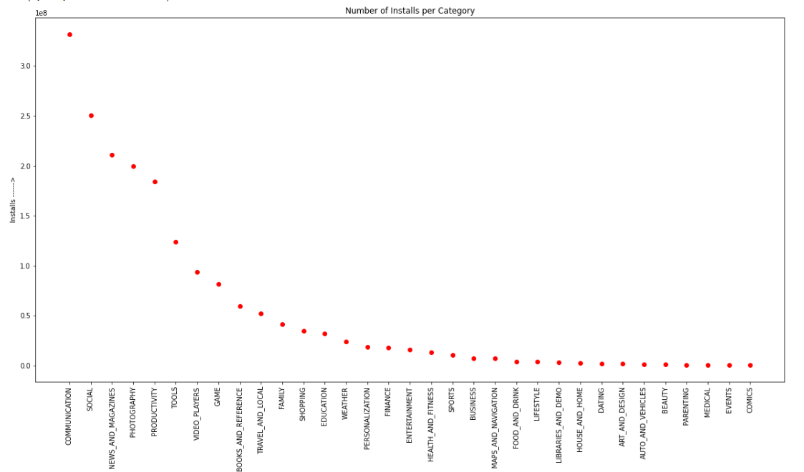
From this graph it tells that category communication got the maximum number of installs.

Slide 17
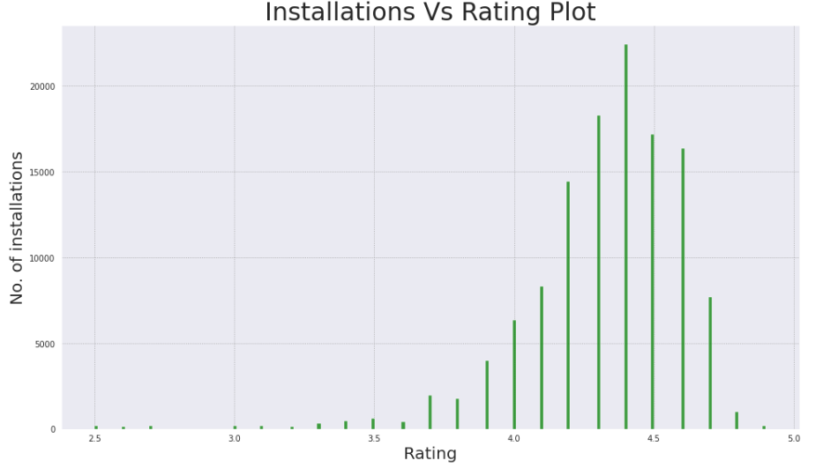
This graph tells that most users are installing the apps which have rating between 4.0 to 4.5 , rating plays the most important role when the user come to download the apps.

Slide 18
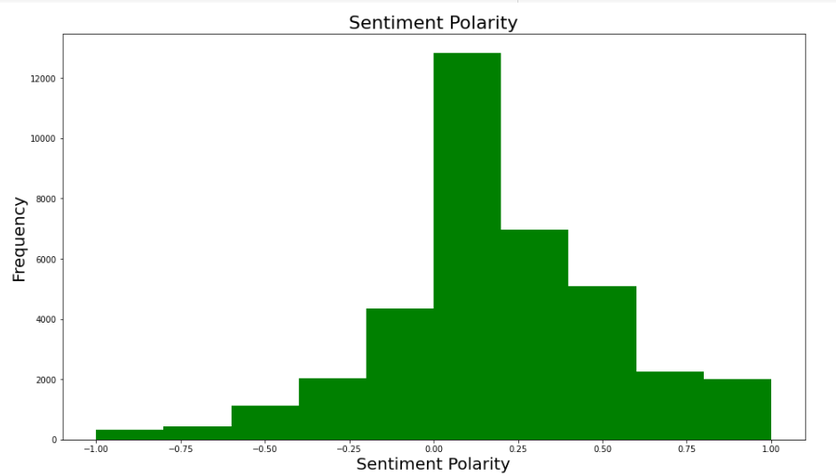
This graph tells us that how many users are liking and disliking the apps and how many are neutral.

Slide 19
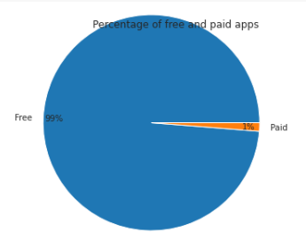
P I E C H A R T A N A LY S I S
It shows that percentage of paid and free apps

Slide 20
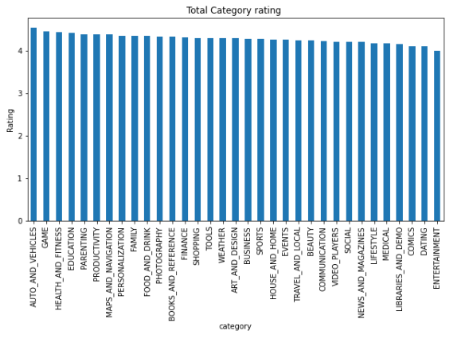

Slide 21
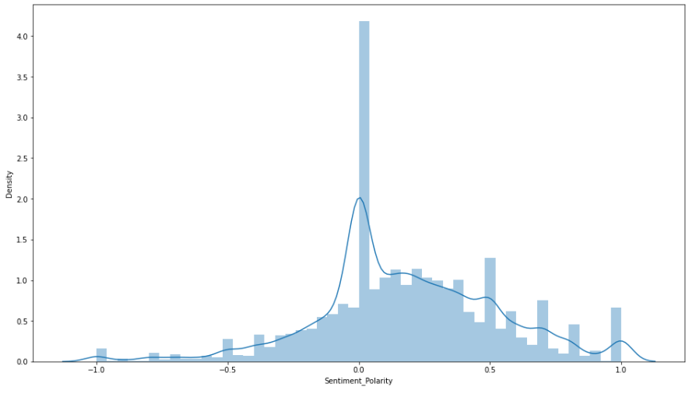
D I S T P L O T A N A LY S I S

Slide 22
Conclusion:
The major purpose of this study was to evaluate the impact of the apps reviews, where a number of models were proposed, intended to explain the relationship between the apps and the users which provides knowledge management practice.
Significant and positive results were found. We have seen that what ever are the category i.e. genre the apps are built, people will review and rate it positively. It totally depends on the organization to make it engaging, people will move towards those apps which came with something interesting.
Also positive reviews have the power to motivate the developers to be more innovative to enhance retention and loyalty.

Slide 23
Thank You

